Slide 1









ROMANGO APP
ROWAN RETAIL

Slide 2
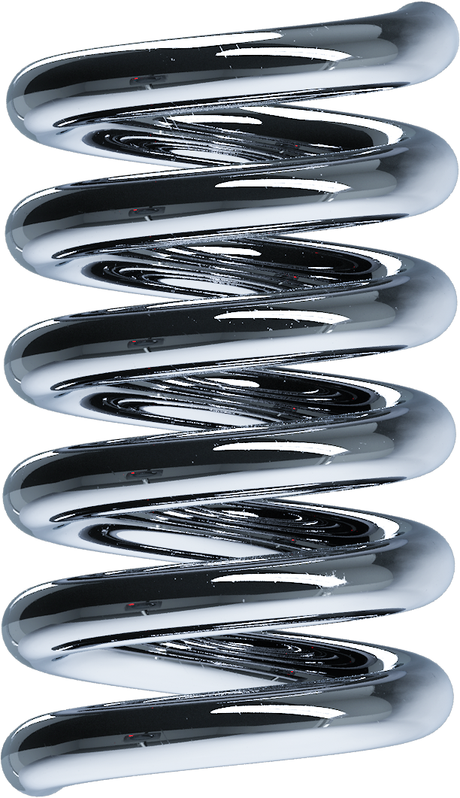


Slide 3
Rowen Retail Customer Contact
ID1 | ID | First | Last | Address | City | State | Zip Code
1 | 1 | Walker | Adkins | 6649 N Blue Gum St | New Orleans | LA | 70116
2 | 2 | Dave | Alston | 4 B Blue Ridge Blvd | Brighton | MI | 48116
3 | 3 | Naomi | Patel | 8 W Cerritos Ave #54 | Bridgeport | NJ | 8014
4 | 4 | Judy | Ng | 639 Main St | Anchorage | AK | 99501
5 | 5 | Luis | Sanchez | 34 Center St | Hamilton | OH | 45011
6 | 6 | Teo | Tadeo | 3 Mcauley Dr | Ashland | OH | 44805
7 | 7 | Britney | Spears | 7 Eads St | Chicago | IL | 60632
8 | 8 | Foster | Jenkins | 7 W Jackson Blvd | San Jose | CA | 95111
9 | 9 | Richard | Castle | 5 Boston Ave #88 | Sioux Falls | SD | 57105
10 | 10 | Meaghan | Garufi | 228 Runamuck Pl #2808 | Baltimore | MD | 21224

Slide 4

YEAR-END PERFORMANCE REVIEW
2024
Want great savings on the go? The new RowanGo app is free and available on iOS and Android. First-time users who download the app get a coupon for 20% off their first purchase. In addition, customers using the RowanGo app to shop get a 2% discount on all future Rowan purchases. Log in using your RowanGo credentials and watch the savings pile up.
RowanGo also offers a new long-asked-for feature: mobile payment. RowanGo digitizes and replaces the credit or debit magnetic stripe card transaction at credit card terminals by allowing users to store debit cards, credit cards, gift cards, loyalty cards, and coupon codes, as well as redeeming sales promotions on their smartphone

Slide 5

https://www.youtube.com/watch?v=N_ZlMNCl9UQ

